Slide 1
EDA Case Study 1
Beers and Breweries Analysis
by Ikenna Nwaogu & Sterling Beason

Slide 2
Goals
Analyze the beer and brewery data and to compare the parameters IBU and ABV contents and how the relate the styles of beer and the region.
Does size of beer matter?

Slide 3
How many breweries are present in each state?

Slide 4
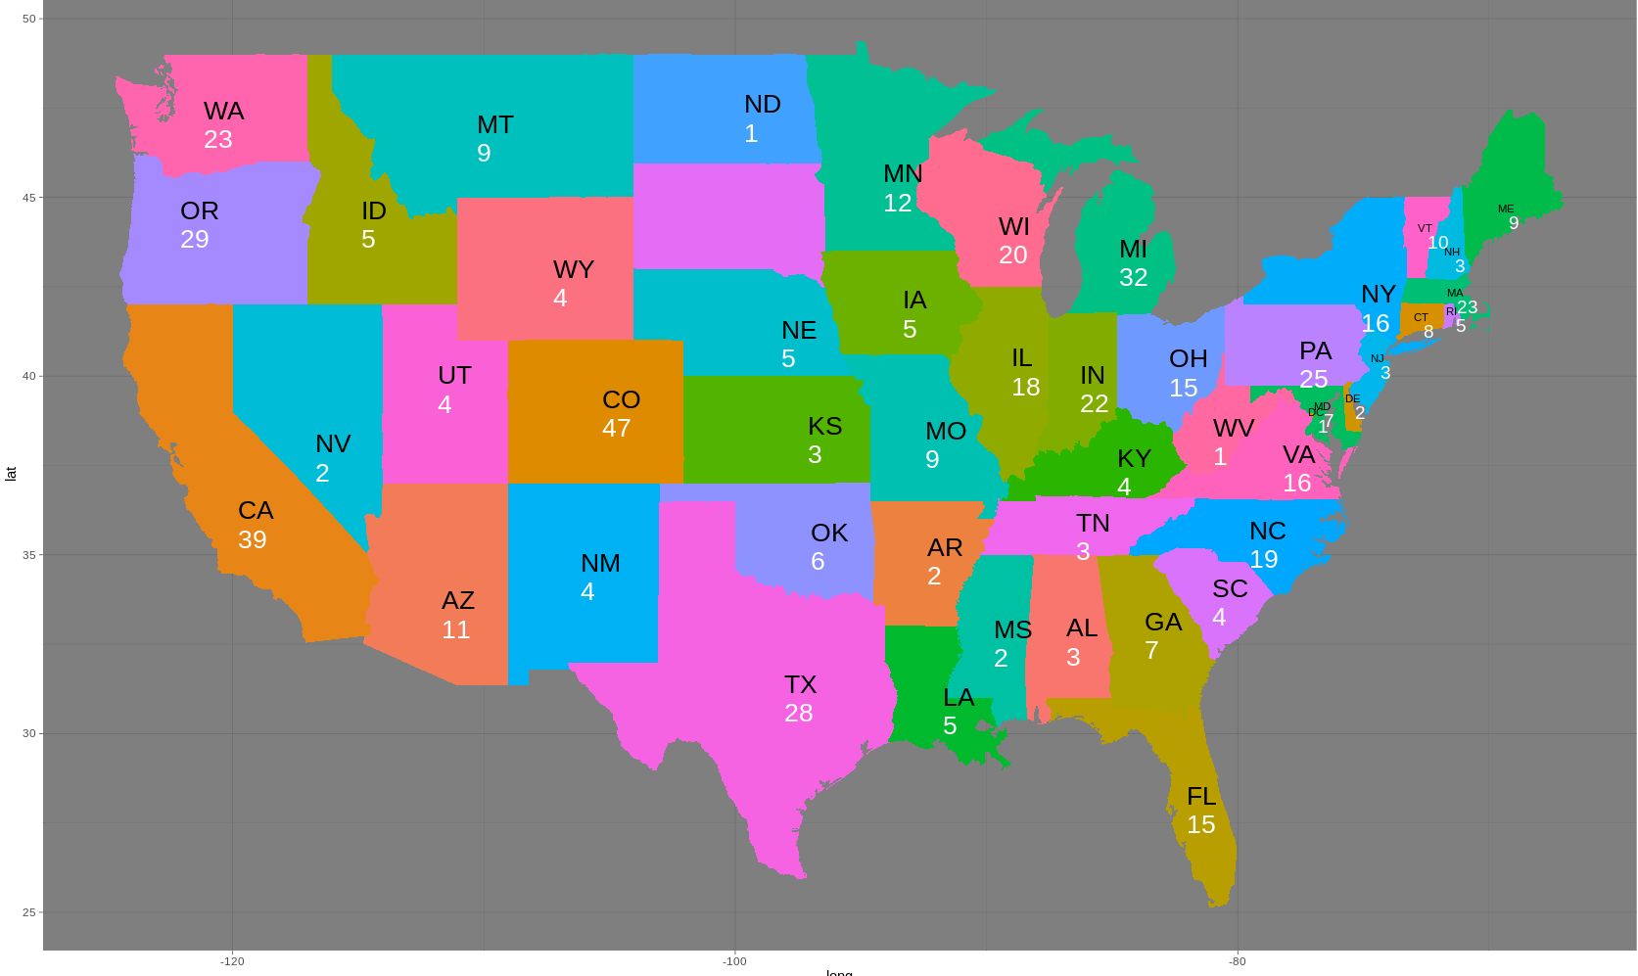
No Of Breweries Per State Except SD, HI & AK

Slide 5
Compute the median alcohol content and international bitterness unit for each state. Plot a bar chart to compare.

Slide 6
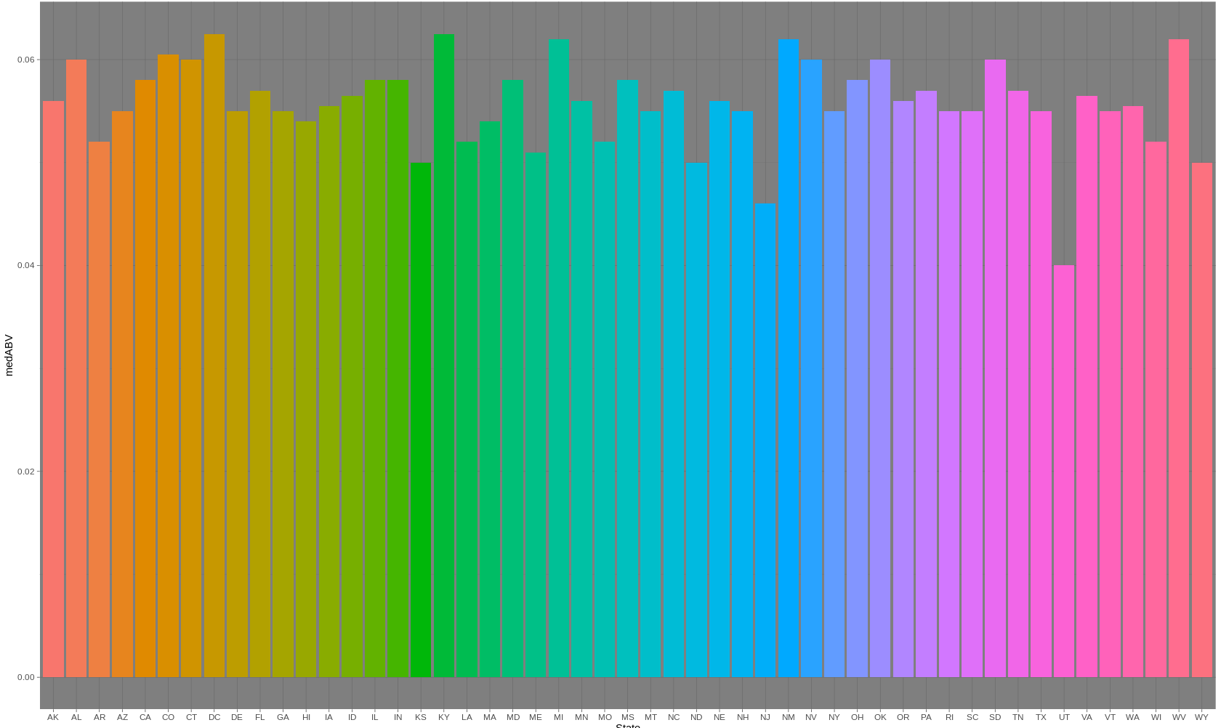
Alcohol Content For Each State

Slide 7
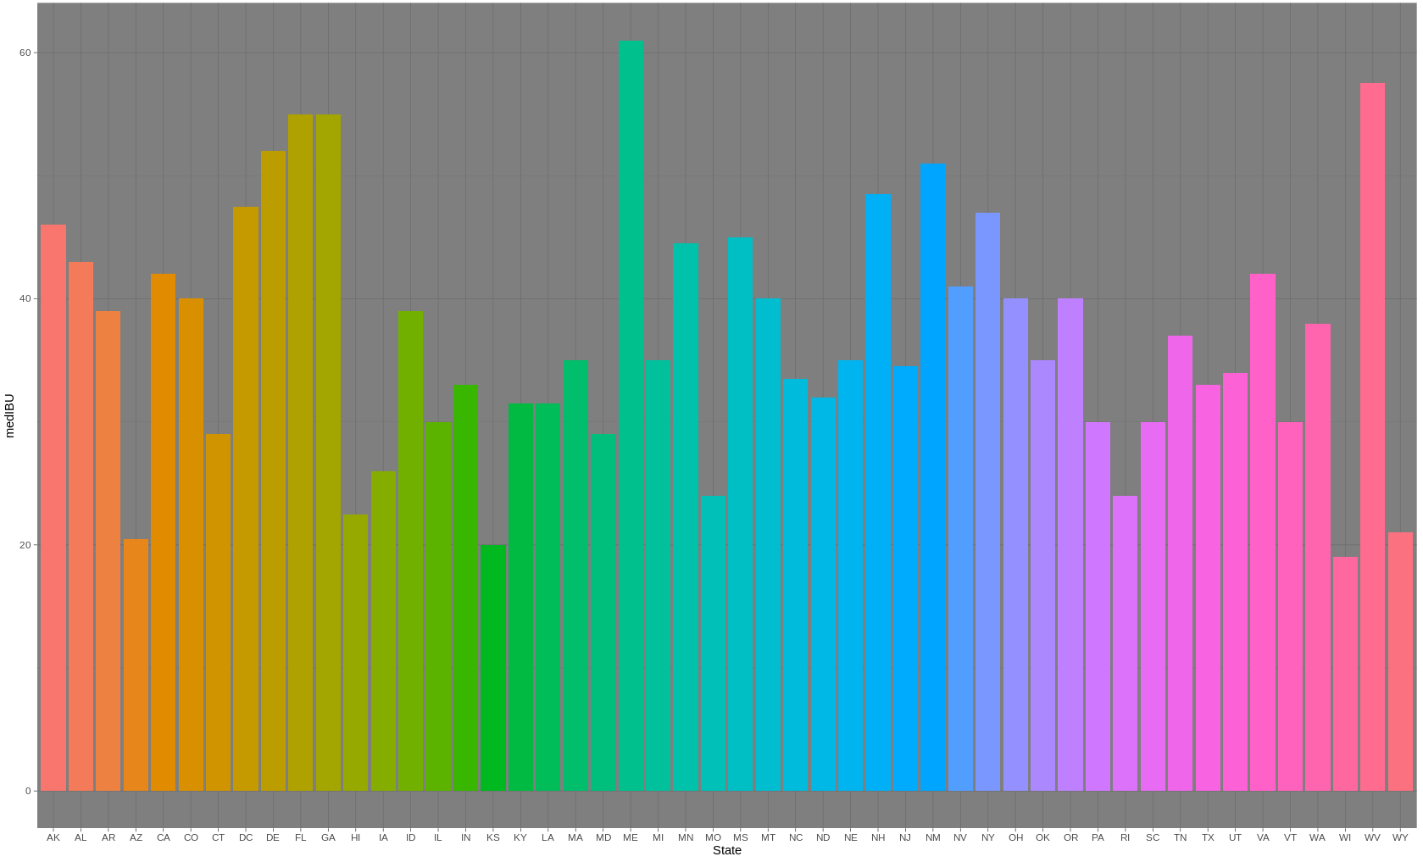
International Bitterness Unit

Slide 8
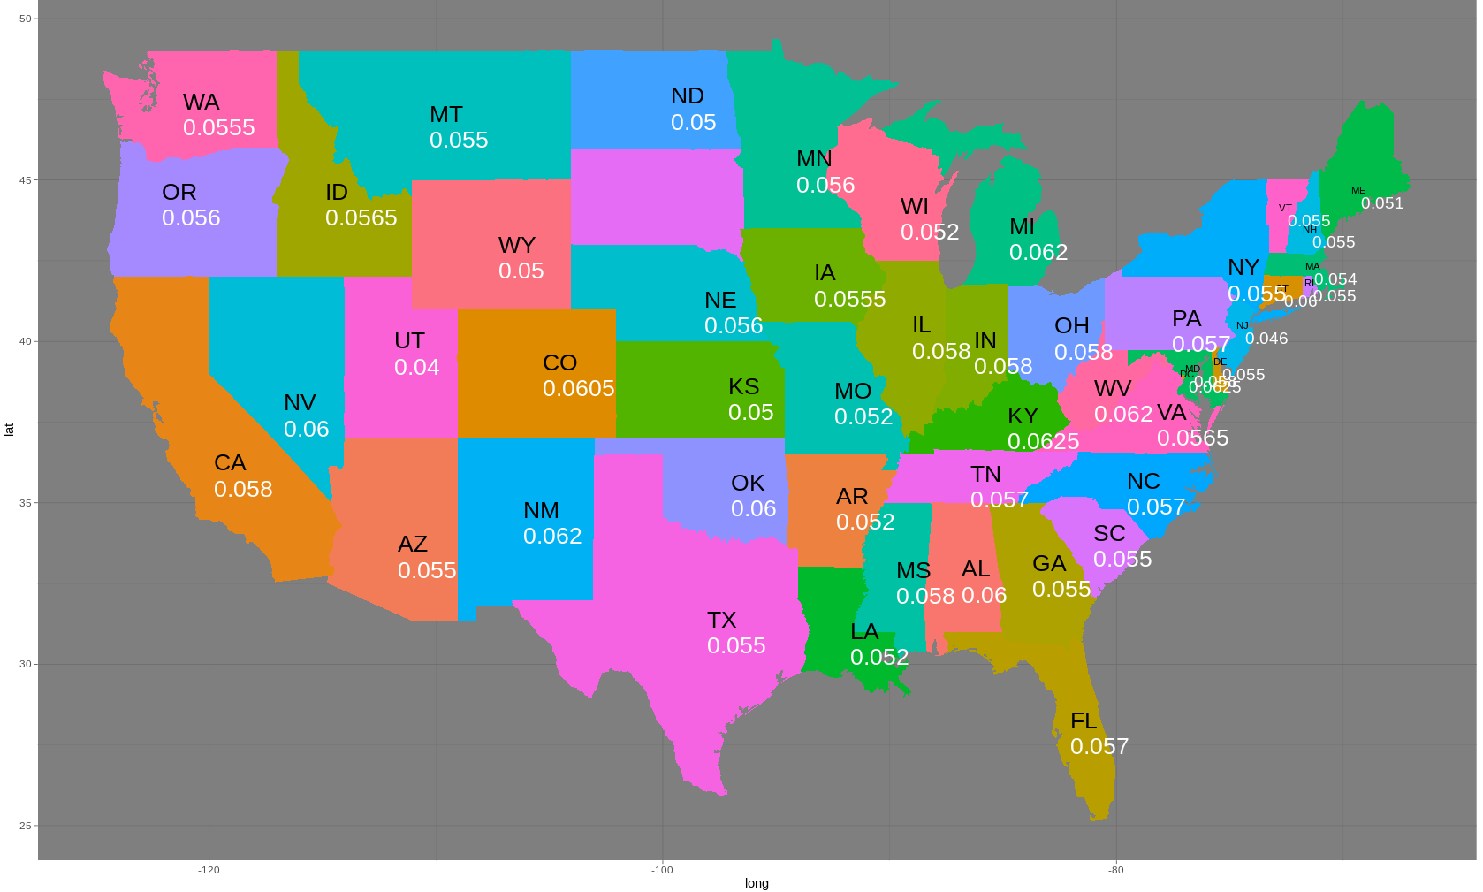
DC And KY has the highest Median

Slide 9

ME has the highest Median IBU

Slide 10
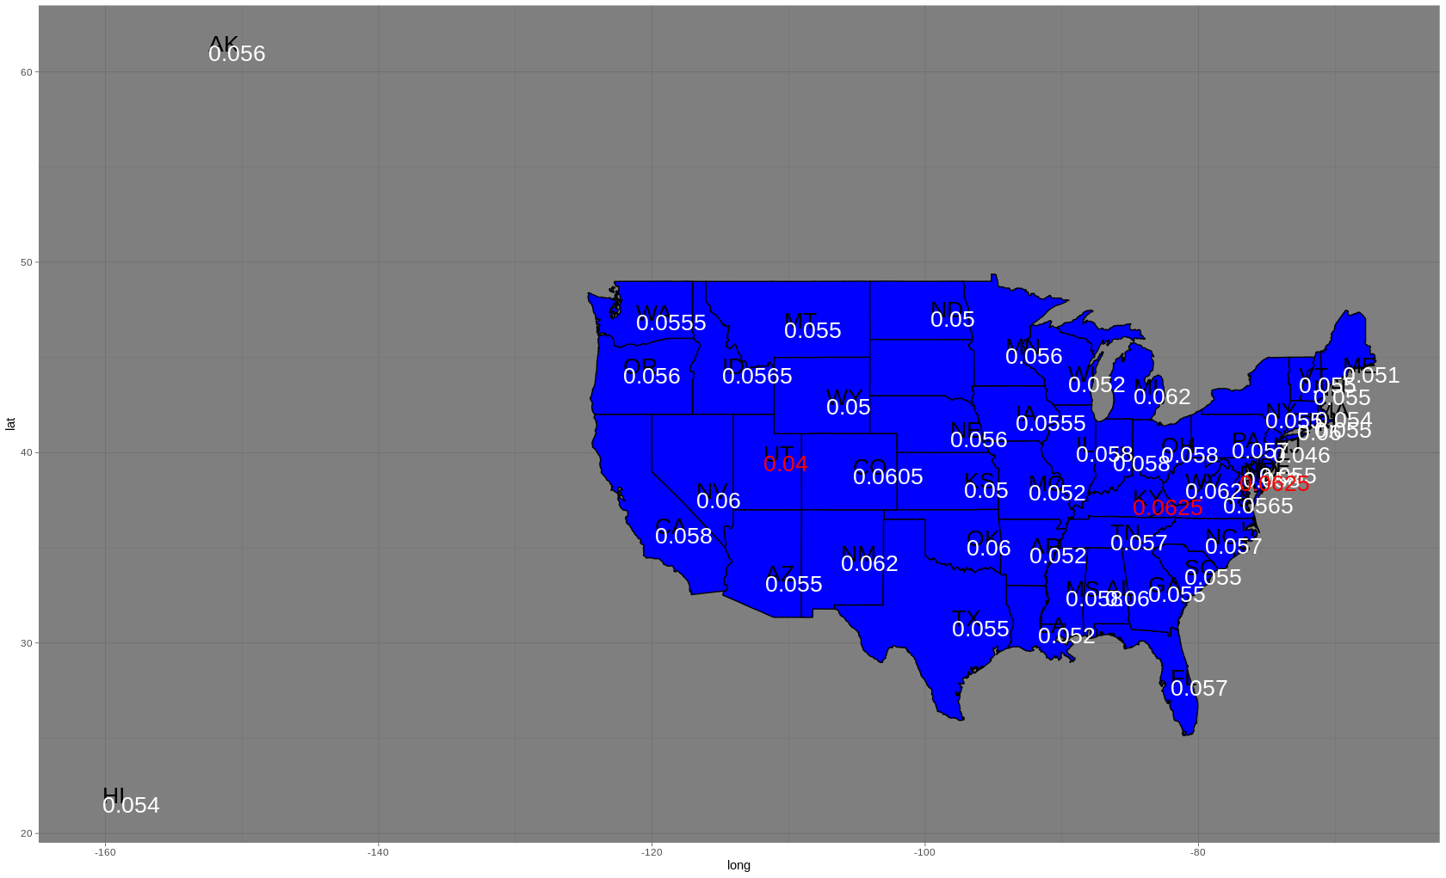
Median ABV with AK & HI

Slide 11
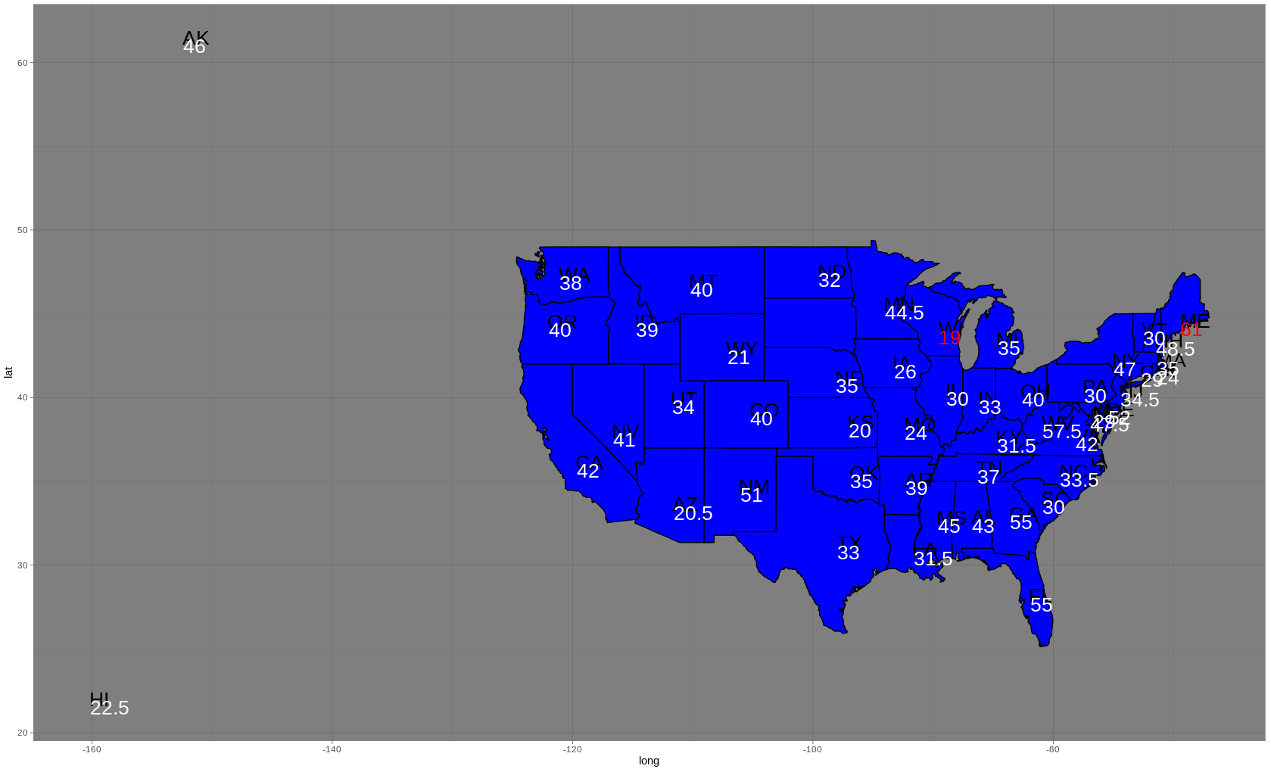
Median IBU with AK & HI

Slide 12
Which state has the maximum alcoholic (ABV) beer? Which state has the most bitter (IBU) beer?

Slide 13
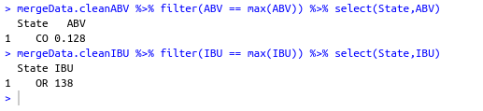

Slide 14
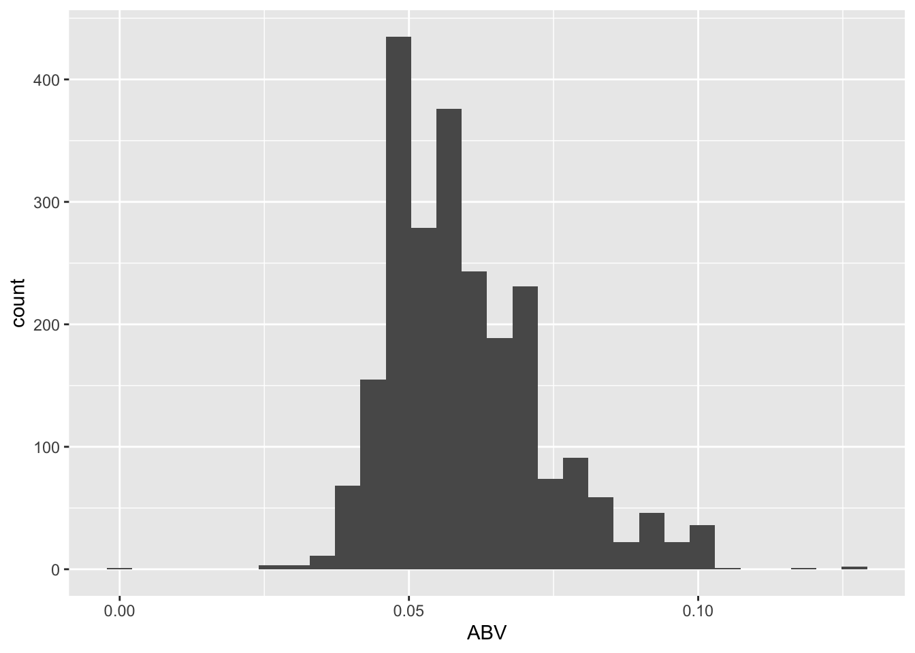
ABV Summary Statistics
The distribution of ABV across beers is slightly right-skewed.
Most beers’ ABV are within 2.5% and 10%.
The median ABV is 5.6% and the mean is 5.98%.
The max ABV is 12.8%.

Slide 15
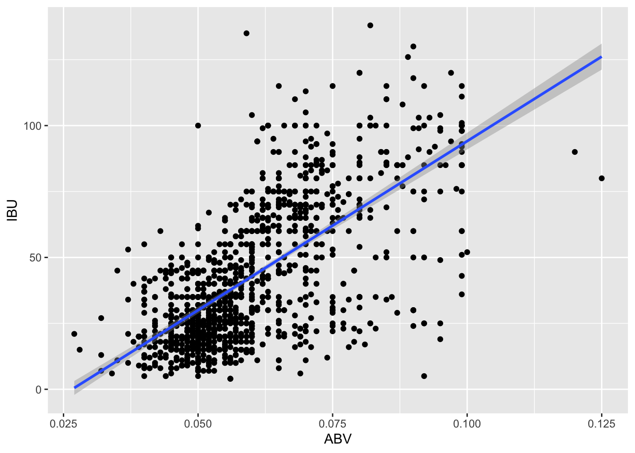
ABV and IBU Relationship
There is a positive relationship between alcohol content and the bitterness of a beer generally.
You can see the higher the ABV, the higher the IBU.

Slide 16
Investigate the difference with respect to IBU and ABV between IPAs (India Pale Ales) and other types of Ale (any beer with “Ale” in its name other than IPA).

Slide 17
Knn model (Cross Validation)
Accuracy (all correct / all) = (TP + TN / TP + TN + FP + FN)
Misclassification (all Incorrect / all) = (FP + FN) / (TP + TN + FP + FN)
Precision (true positives / predicted positives) = TP/(TP+FP)
Sensitivity/Recall (true positives / all actual positives) = TP/(TP+FN)
Specificity (true negatives / all actual negatives) =TN/(TN + FP)
Accuracy, Sensitivity and Specificity are the more important parameters to use.

Slide 18

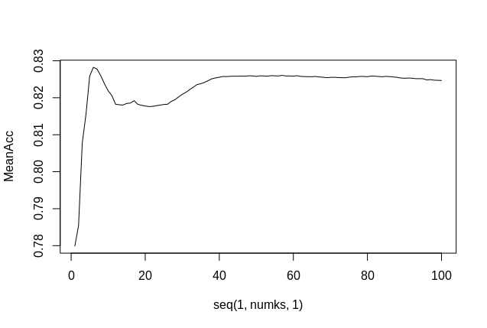
Knn model Using IBU and ABV
Analyzed K based on the best accuracy. 100 Ks with 500 iterations of different split.
K = 6
Accuracy = 0.83
Sensitivity = 0.87
Specificity = 0.79

Slide 19
Knn model Using IBU and ABV
Using the K to analyze changes from 500 iterations of split to 100
K = 6
Accuracy = 0.83
Sensitivity = 0.87
Specificity = 0.79
We get the same result.

Slide 20

Knn model Using ABV And IBU Separately With Size
Using the NA rows
Knn model Using IBU And Size
K = 6
Accuracy = 0.80
Sensitivity = 0.86
Specificity = 0.74
Knn model Using ABV And Size
K = 6
Accuracy = 0.73
Sensitivity = 0.80
Specificity = 0.63
There are 2410 rows in the data-set.

Slide 21
Takeaways
From our analysis, IBU is more important parameter for classifying beer.
We need more data, less NA’s especially for more important parameters.
It doesn’t seem like size beers matters when classifying as either IBU or ABV

Slide 22
Takeaways
From our analysis, IBU is more important parameter for classifying beer.
We need more data, less NA’s especially for more important parameters.
It doesn’t seem like size of beers matters when classifying with either IBU or ABV

Slide 23
END

